Slide 1

Orion
Analytics
A data analytics start-up trying to make the world a better place, one solution at a time.

Slide 2

THE COMPANY
Founded by three ambitious python developers : Daisy, Harini and Satish of St. Joseph’s college (Autonomous), Bengaluru, on a cold, rainy day in June 2019.
What started out as a quest to get marks for a project turned into an idea for a start-up that is ‘Orion Analytics’.
We chose the name Orion because it’s a constellation and the Orion’s belt has 3 stars, all in a row, displaying no hierarchy, much like our small team of 3 people.
We work on multiple domains and solve problems related to data analysis.

Slide 3
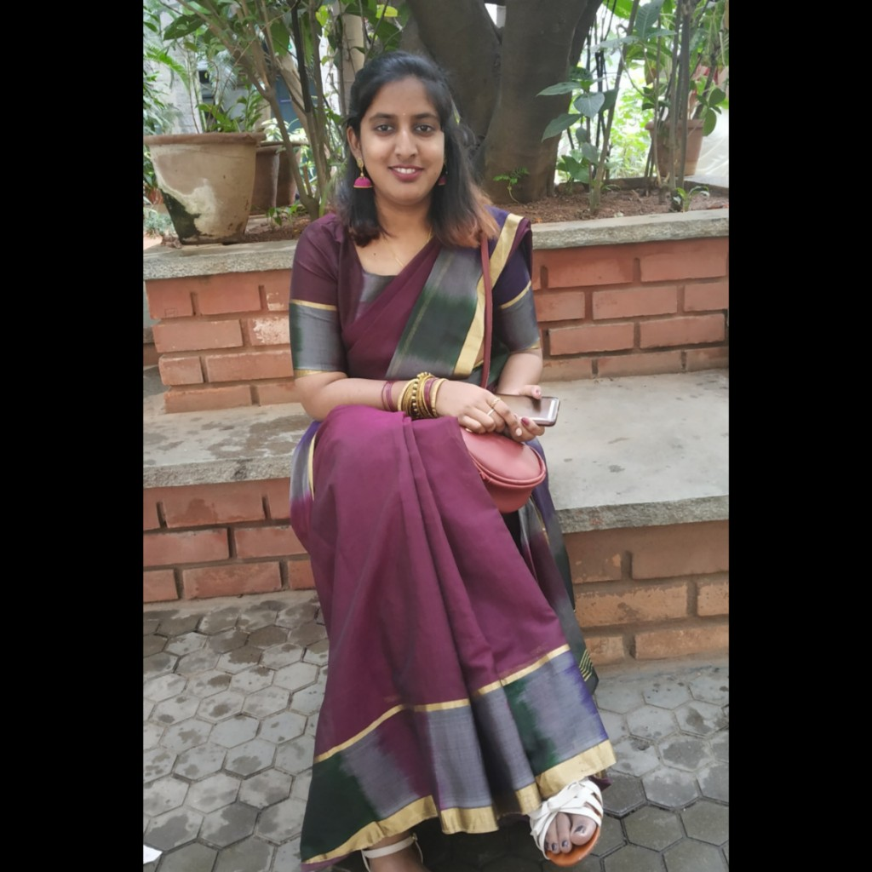
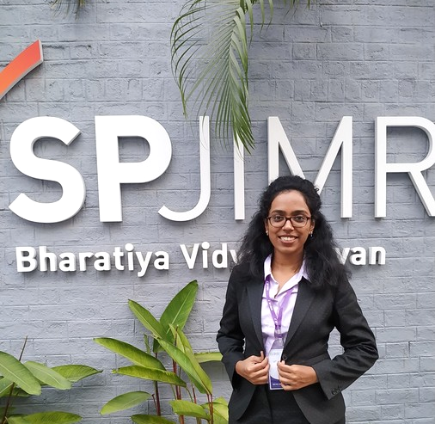
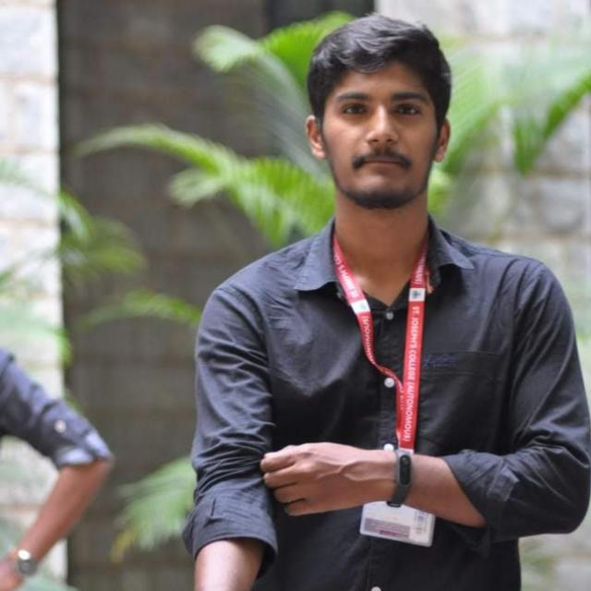
✋ Meet the team! ✋
Hello! I am Daisy. I love art. I would rather be art-ing right now. But I guess data analysis is also a kind of art?
Hello! I am Harini. I am here because I love presentations. No, I am not joking. Amy from B99 is my spirit animal.
Hello! I am Satish. I like biking through mountains.

Slide 4



OUR SERVICES
Marketing analytics
Applying analytics to enhance the impact of your marketing expenditure
Customer Analytics
Analyze and understand your customers for better engagement and returns
Custom solutions
Plan and optimize your investment in business operations
Analytics in Healthcare
Enable better patient access through more efficient care delivery with the right staffing and skills.
Risk Analytics
Drive your business into profit with intelligent risk analytics and improve your company’s security.
Social Media Analytics
We help you optimize your social media presence and make the most out of it.

Slide 5

Orion Analytics
presents
RELAX
We have it under control

Slide 6

50 to 70 million Americans chronically suffer from a disorder of sleep and wakefulness
The cumulative long-term effects of sleep loss
It take a toll on nearly every key indicator of public health
Some of these consequences, such as automobile crashes, occur acutely within hours (or minutes) of the sleep disorder
Most common yet frequently overlooked and readily treatable health problems.
The Problem
How well are you sleeping?

Slide 7
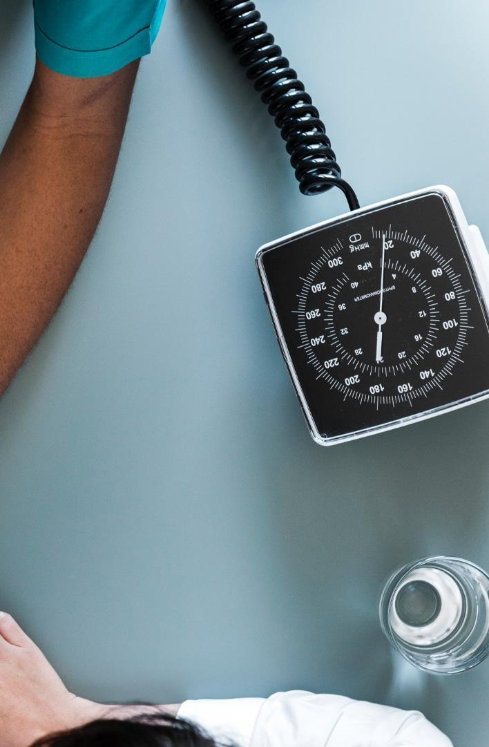




Unique
First to Market
Our service is unique because we don’t need you to spend time taking blood tests and other tests
Our service is the first of its kind in the market. Therefore we have a huge untapped potential.
Our Product
Tested
Reliability
Our service has been tested on 900 people so far and helped them get their sleep problems resolved
Reliable source of health report.

Slide 8
HOW DOES IT WORK?
Relax is a software that helps hospitals or equipped persons collect and analyze data related to sleep disorders
Collect polysomnography data during sleep such as ECG, EEG, EMG (13 such signals)
Classify as a person having sleep disorder or not based on the number of sleep arousals they have
If yes, which kind of sleep disorder can be told by the pattern observed – is it apnea related or non-apnea related?
Give it as a report so the hospitals can give effective treatment accordingly.
The backend of our app uses Deep Neural Network to process the data

Slide 9
THE STORY SO FAR AND THE FUTURE
We have collected polysomnographic data of 900 patients and classified them as arousal and non-arousal using Deep Neural Networks.
We are getting an accuracy of 75% which is really good at this stage of development in this field
With enough funding, we will be able to:
Gain more computational resources and hence run the diagnosis for multiple people at the same time
Location scalability
Rope in more data analysts to operate the software

Slide 10




STRENGTHS
WEAKNESSES
Clear target audience
Easy to use – uncomplicated process
Easily accessible – can be done even at home
Will be hard to build a reputation without big companies endorsing for us
Lack of capital and low computational resources
S
W
O
T
OPPORTUNITIES
THREATS
First in the market – lot of untapped potential. No competitors.
Collaborate with govt hospitals, to establish brand name for self and the investors.
Being unprepared for a large number of people
Location wise scalability

Slide 11
DEMO – How the app works

Slide 12
If you have any questions or suggestions, do leave them in the comment section below.
THANKS FOR WATCHING

